Slide 1
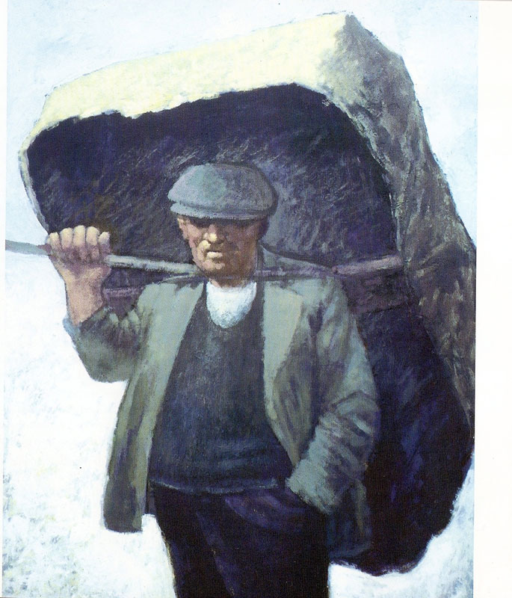
Used with kind permission of Aneurin Jones
A series of interactive lessons and instructions for teachers to create a art project:
Years 5 a 6
Lesson 3
Workers and the workhouse during Victorian Times
Next page
Notes:
1

Slide 2
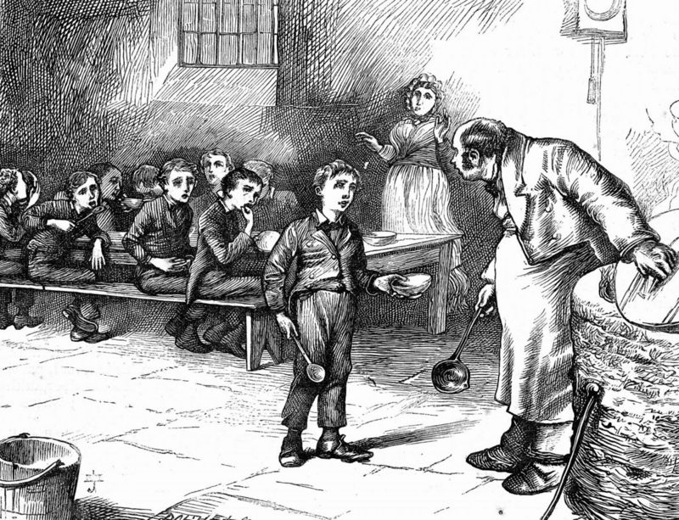
Creating a picture using the imagination
Task: To sketch a picture of a Victorian Workhouse by listening carefully to a piece of text.
Your teacher is looking for sketches that show conditions workers in the Workhouse faced and features of a building from Victorian Times.
Previous page
Next page

Slide 3
Before you begin your imaginative picture of life in the workhouse, here are some things that you must remember in order to convey the conditions of life during this time.
You should listen for…
A description of the workhouse building.
What type of life the people who lived there had?
Are they rich or poor?
How do you imagine they feel to be in this type of place?
How do you think they look?
What emotions would their faces and their bodies convey?
How are they dressed and what do their clothes say about them?
Previous page
Next page

Slide 4
An example of a written piece suitable for this task:
Street Child by Berlie Doherty (published by Collins)
“Take ‘em to the workhouse” the policeman said. “Let them die in there, if they have to”. The boy began to run then, head down, skidding on the snowy road, weaving the cart in and out of the carriages, and Jim ran anxiously behind. They came at last to a massive stone building with iron railings round it. Weary people slouched there, begging for food. The boy stopped the cart outside the huge iron gates and pulled the bell. Jim could hear it clanging in the distance. At last the gates were pulled open by a porter who glared out at them, his lantern held up high.
There on the steps on each side of the main door stood a man and a woman, as straight and thin and waxy-faced as a pair of church candles, staring down at them. The boy held out his hand and was given a small coin, and the master and matron bent down and lifted Jim’s mother off the cart and carried her into the house. The boy pushed his cart out and the porter clanged the gates shut. The matron poked her head sharply round the door.
“Get in!” she told Jim, and pulled him through. “You come and get scrubbed and cropped”.
The doors groaned too. They were in a long corridor, gloomy with candle shadow. In front of them a man trudged with Jim’s mother across his shoulder.
Used with kind permission of David Higham Associates
Previous page

Slide 5
The matron closed her ice-cold hand over his and bent down towards him, her black bonnet crinkling. Her teeth were as black and twisted as the railings in the yard.
She pulled Jim along the corridor and into a huge green room, where boys sat in silence, staring at each other and at the bare walls. They all watched Jim as he was lead through the room and out into another yard.
“Joseph!” the matron called, and a bent man shuffled after her. His head hung below his shoulders like a stumpy bird’s. He helped her strip off Jim’s clothes and to sluice him down with icy water from the pump. Then Jim was pulled into rough, itchy clothes, and his hair was tugged and jagged at with a blunt pair of scissors until his scalp felt as if it had been torn into pieces. He let it all happen to him. He was too frightened to resist. All he wanted was to be with his mother.
He was lead back into a huge hall and told to join the queue of silent boys there. They stood with their heads bowed with bowls in their hands. There were hundreds and hundreds of people in the room, all sitting at long tables, all eating in silence. The only sound was the scraping of the knives and forks and the noise of chewing and gulping. All the benches faced the same way. Mr Sissons stood on a raised box at the end of the room, watching everyone as they waited for food. Jim was given a ladle of broth and a corner of bread.
After the meal the man with the hanging head gave Jim a blanket and showed him a room full of shelves and long boxes where all the boys slept. He pointed to the box Jim was to sleep in. Jim climbed into it and found that he only had enough room to turn over in it, small though he was. He tied Lizzie’s boots to his wrists in case anyone tried to steal them. The dormitory door was locked, and they lay in darkness.

